Slide 1
Lab Exercise 3
Augmenting the Thermal Conductivity of PCM Using CuO Nanoparticle

Slide 4
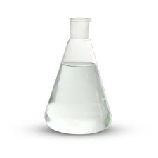
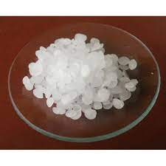
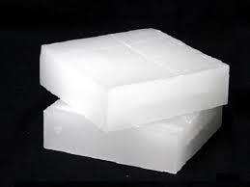
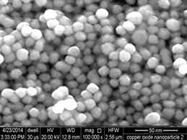
Augmenting the thermal conductivity of a
Phase Change Material (PCM) Using Nanoparticle

Slide 5
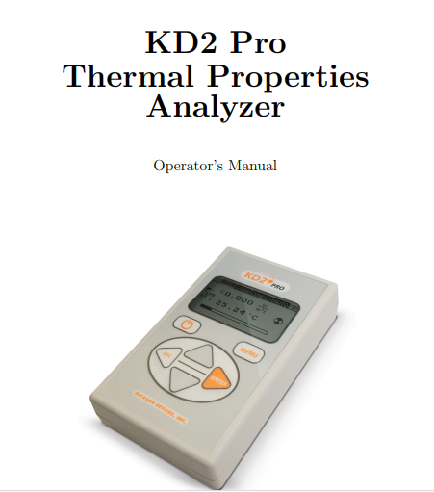
Thermal conductivity of PCM blended with CuO nanoparticle (Experimental)

Slide 6
Thermal conductivity of PCM blended with CuO nanoparticle (Analytical)
Solid
Maxwell Garnett Equation
Liquid
Bhattacharya et al Equation

Slide 7
Lab Exercise 2
Consider 16 observations (8 for solid state and 8 for liquid state) from the given dataframe. Perform the following using R Programming for analytical and experimental values,
Determine the grand mean, and mean of thermal conductivity.
Sum of Squares between and Sum of Squares within
Degrees of Freedom (Between, Within and total)
Mean Squares (Between and Within)
F_Statistic and F Critical
Check, Is Null hypothesize accepted?
Plot Vol. Concentration VS Thermal Conductivity
Plot Vol Concentration Vs % increase in Thermal conductivity –(In bar chart)
Error (Measured Value-Analytical Value)

